Slide 1
Space: The Final Economic Frontier
State of play and an early framework
Matthew Weinzierl
May, 2019

Slide 2
Today
Early observations and structuring of the topic
  Hopefully not pedantic
  Meant to provide a framework for understanding and managing the development of the space economy
A spur to further work

Slide 3
Existing work
Long but small tradition of economists working on space policy
  GWU’s Space Policy Institute a leading center (esp. Henry Hertzfeld)
  Some at NASA, even (Alex MacDonald)
A few others (esp. Molly Macauley, Macauley and Toman AER P&P 1991)
But little sustained work in academic economics
  I think the time is ripe for more engagement
  This paper takes some early steps reflecting my early thinking

Slide 4
Flight plan
Basic economics of the space program
Framework for understanding and managing the development of the space economy
Two closing questions

Slide 5
The basic economics of the space program
Let’s begin with a practical question. Should the space program:
  Start with the government and add the market as needed, or
  Start with the market and add the government as needed?

Slide 6
The basic economics of the space program
First Fundamental Theorem of Welfare Economics
  A competitive market with informed participants, in which private and social costs and benefits are aligned, will yield the maximum total gains from trade, or social surplus.
Key advantages of the market
  Information aggregation through the price mechanism
  Competition provides incentives tailored to supply and demand
As a result, markets can bring enormous benefits to society

Slide 7
The basic economics of the space program
Market failures are ways in which markets do not meet the criteria of the 1FTWE:
Imperfect competition (monopolies)
Imperfect information (moral hazard, adverse selection)
Private and social costs and benefits differ (externalities, public goods)
Market failures make room for government intervention (possibly) to increase the total gains from trade, or social surplus
In principle, everyone can gain from government intervention in these cases

Slide 8
The basic economics of the space program
Let’s return to our practical question. Should the space program:
  Start with the government and add the market as needed, or
  Start with the market and add the government as needed?

Slide 9
The basic economics of the space program
In other words, what’s more important for the space program:
  What the market gets wrong, or
  What the market gets right?
The Soviet Union was built on the idea that what the market gets wrong is more important, so we should start with the government and add the market as needed:
  Priorities:
    National Defense and Pride (classic public goods)
    Basic science and R&D (classic case of positive externalities)
  Less important: apples vs. oranges

Slide 10
The basic economics of the space program
NASA was built on the same idea because the US (and the USSR) had precisely these priorities for space :
  National Defense and Pride
  Basic science and R&D
  “The same aerospace industry that put a man on the moon and defeated the great Soviet threat in the defense of capitalism was, and still is, operating on a Soviet economic model.”
  Jim Cantrell, SpaceX

Slide 11
Primer on space history
1957: Soviets launch Sputnik; space race begins
1969: Apollo program=5% of Federal Budget; lands on Moon
1970s: NASA’s second act debate settles on Shuttle

Slide 12
The basic economics of the space program
It turned out that running a space program through the government rather than the market led to substantial problems:
  Inefficiencies, cost overruns
  Slower innovation than expected
  Dependence on public funding rather than market demand

Slide 13
The basic economics of the space program
It turned out that running a space program through the government rather than the market led to substantial problems:
  Inefficiencies, cost overruns
  Slower innovation than expected
  Dependence on public funding rather than market demand
Why? For the same reason that the Soviet economic system failed: the tools of the market are simply too valuable to forego:
  Without an active price mechanism, the allocation of resources is inefficient
  Without incentives from competition, innovation and efficiency decline
Experimentation with the other option—putting the market first—became a necessity

Slide 14
Primer on space history
1957: Soviets launch Sputnik; space race begins
1969: Apollo program=5% of Federal Budget; lands on Moon
1970s: NASA settles on Shuttle
-2000s: Shuttle builds ISS, Hubble, but disappoints. Crashes lead to cancellation in 2010, leaving the US with no way to launch astronauts.
Two alternatives:
  Constellation: major, conventional program
  COTS: Small, experimental PPP to spur space startups
2010: Constellation program canceled; COTS launches a new era

Slide 15
The shift to the new model
In the past two decades we’ve seen a major shift in this model
  The cancellation of Shuttle and the experimentation with COTS was the inflection point
  COTS led to flourishing of “New Space” sector and revolution in costs of space access
    NASA’s own cost estimates of ISS resupply had commercial trips 1/2 to 1/3 as expensive as its own would have been
  For the first time, government and private sector priorities will share center stage in space

Slide 16
Primer on space history
1957: Soviets launch Sputnik; space race begins
1969: Apollo program=5% of Federal Budget; lands on Moon
1970s: NASA settles on Shuttle
-2000s: Shuttle builds ISS, Hubble, but disappoints. Crashes lead to cancellation in 2010, leaving the US with no way to launch astronauts.
Two alternatives:
  Constellation: major, conventional program
  COTS: Small, experimental PPP to spur space startups
2010: Constellation program canceled; COTS launches a new era
2012: SpaceX first commercial ISS resupply mission, legacy of COTS
2015: Blue Origin first reusable rocket launch and return
2017: NASA 2017 Act: LEO gradually turned over to commercial sector priorities and operation
2019: Reusable, crewed flights to the edge of space and the ISS

Slide 17
Flight plan
Basic economics of the space program
Framework for understanding and managing the development of the space economy
Two closing questions

Slide 18
An early framework for managing space
The role for the government can be thought of in three stages:
  Establish the market: decentralization
  Refine the market: address market failures
  Temper the market: pursue social objectives

Slide 19
An early framework for managing space
The role for the government can be thought of in three stages:
  Establish the market: decentralization
  Refine the market: address market failures
  Temper the market: pursue social objectives

Slide 20
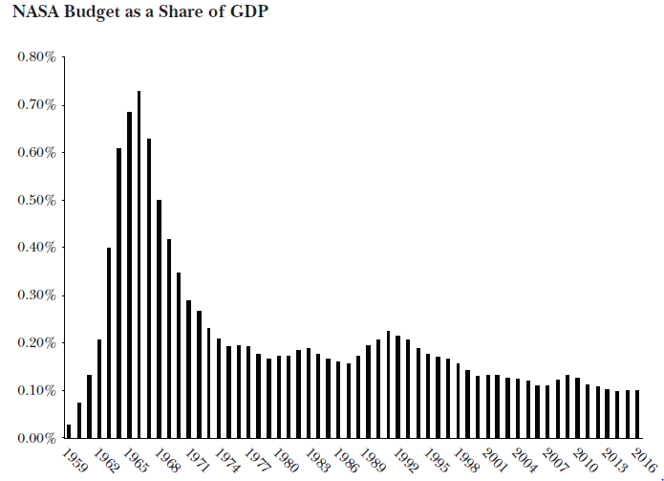
Establish the market: decentralization
NASA’s budget has fallen by nearly an order of magnitude since Apollo as share of GDP (though flat in dollar terms)
Stagnant for decades, no sign of big increases in the future

Slide 21
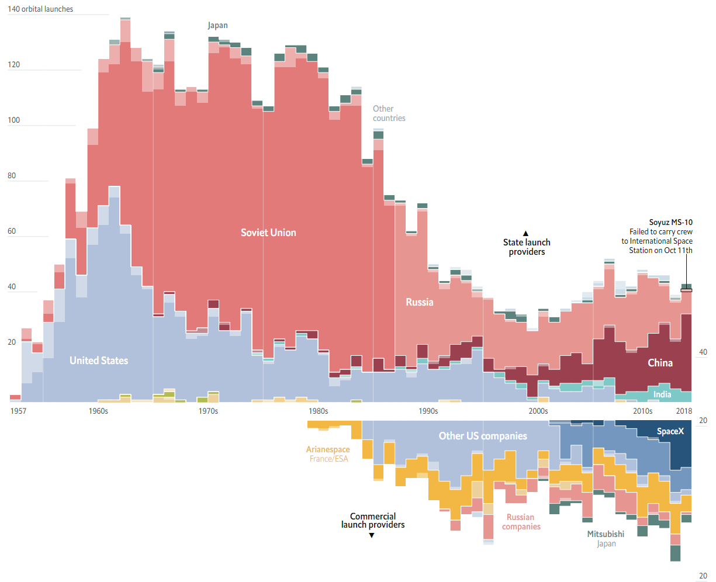
Establish the market: decentralization
Launches have shifted wholesale to the private sector in the West
  Note COTS impact in 2010s
Source: The Economist, Oct 2018

Slide 22
Establish the market: decentralization
March 2017, NASA Transition and Authorization Act:
  “NASA shall pursue a step-wise transition of low-Earth orbit human spaceflight operations from a Government-directed activity to a model where private industry is responsible for how to meet and execute NASA's requirements.”
  Opens up LEO to dedicated scientific research platforms, such as for research in genetics
Open question as to how much NASA will follow a decentralized path for Moon, Mars, and further exploration
  Current debates over return to the Moon suggest a mixed strategy, using conventional programs (SLS) and PPPs (Commercial Lunar Payload Services contracts with 9 firms)

Slide 23
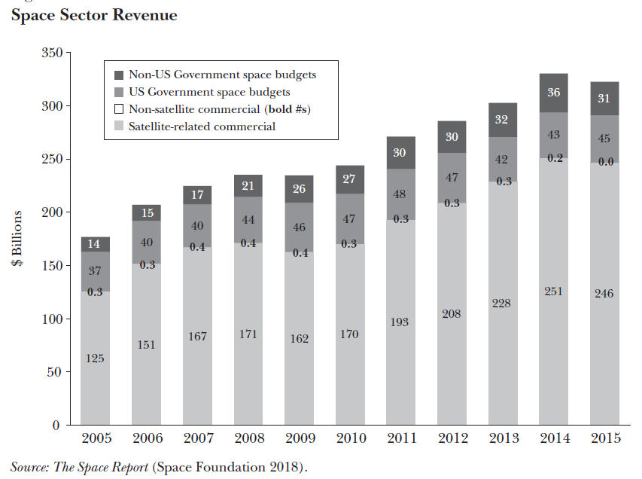
Establish the market: decentralization
Outside of satellites, lots of room for growth!

Slide 24
An early framework for managing space
The role for the government can be thought of in three stages:
  Establish the market: decentralization
  Refine the market: address market failures
  Temper the market: pursue social objectives

Slide 25
Refine the market: address market failures
A number of market failures in space
  Imperfect competition: high fixed costs generate monopolies
  Negative externalities: space debris risk (tragedy of the commons)

Slide 26
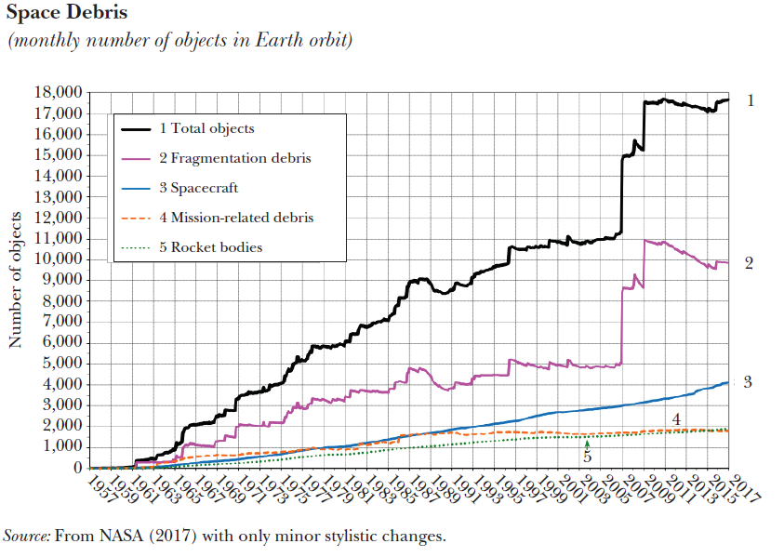
Establish the market: decentralization
New constellations may raise threat level

Slide 27
Refine the market: address market failures
A number of market failures in space
  Imperfect competition: high fixed costs generate monopolies
  Negative externalities: space debris risk (tragedy of the commons)
  Perhaps most important: positive externalities or “complementarities”
The success of the business models of most space companies depends on the success of the business models of other space companies
Note that such a situation is likely to lead to market power via vertical and horizontal integration if left unchecked

Slide 28
Refine the market: the stag hunt
Three features
Two players; each can hunt a hare or stag
Hares can be hunted individually; stags must be hunted together
Stags are worth much more than hares
Two equilibria, one better
If one hunts hares, the other should too
If one hunts the stag, the other should too
One key question
How do we get over the tipping point?
Main point
Each hunter is a complement to the other when hunting stags, but neither gets compensated for those complementarities if acting alone

Slide 29
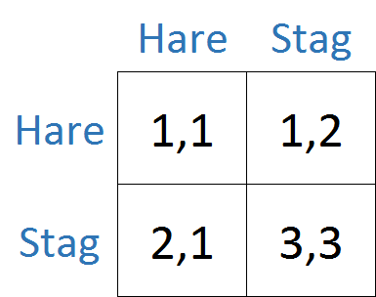
Refine the market: incentives
Suppose the government changes the payoffs through subsidies and taxes
  Subsidizes unsuccessful stag hunting
  Taxes successful stag hunting
Now, only equilibrium is Stag
Over the tipping point: all win!
  The government solves complementarities
Note that private firms may integrate to replicate this solution

Slide 30
An early framework for managing space
The role for the government can be thought of in three stages:
  Establish the market: decentralization
  Refine the market: address market failures
  Temper the market: pursue social objectives

Slide 31
Temper the market: pursue social objectives
The shift from public to private priorities in space is especially significant because a widely shared goal among commercial space’s leaders is the achievement of a large-scale, largely self-sufficient, developed space economy.

Slide 32

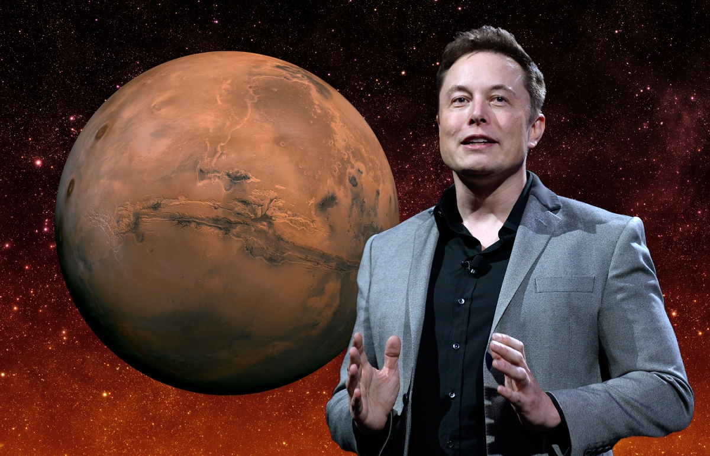
Two leaders of the space sector
Jeff Bezos
Founder of Blue Origin
Lord of Space Colonies?
Elon Musk
Founder of SpaceX
King of Mars?

Slide 33
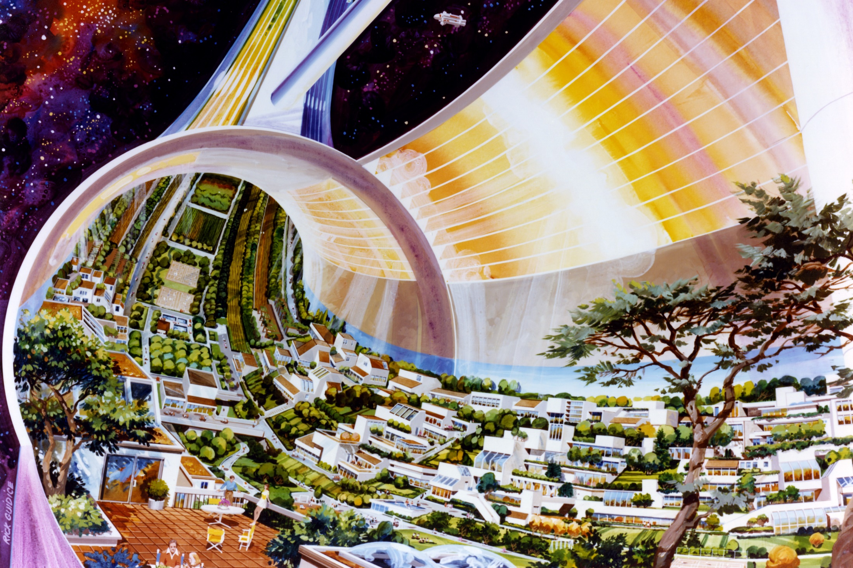
Bezos’s plan
1970s rendering of O’Neill space colony
Jeff Bezos envisions these as settlements
  Stated goal: “millions of people living and working in space”
  Net worth=$132 billion (NASA’s full space operations budget=$5 billion)

Slide 34
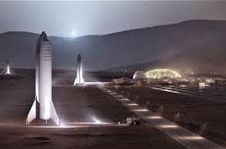
Musk’s plan
Rendering of SpaceX’s Mars Base with BFR (now “Starship”)
Elon Musk plans to settle Mars with one million people, first flight 2024/2026
  Says the chance he will move to Mars in his lifetime is “70%” (he’s 47)

Slide 35
Temper the market: pursue social objectives
The shift from public to private priorities in space is especially significant because a widely shared goal among commercial space’s leaders is the achievement of a large-scale, largely self-sufficient, developed space economy.
Who will gain from expanded space activities?
  Who has property rights to the resources of space?
  1967 Outer Space Treaty is ambiguous
  2015 Commercial Space Launch Competitiveness Act changed the game
Who controls governance in space?
  Who decides on our objectives in space?
  UN?
  Role of a Space Force?

Slide 36
Flight plan
Basic economics of the space program
Framework for understanding and managing the development of the space economy
Two closing questions

Slide 37
Two closing questions
Why are we going to space?
What role can economists play?

Slide 38
Why are we going to space?
National security and pride (but implies limited programs)
Science (but robots are better)
Profit
  Earth observation and telecom (but imply limited programs)
  Space manufacturing, solar energy, mining (but all very uncertain)
Exploration (but limited numbers)
Temporary and eventually permanent settlement…the real tipping point

Slide 39
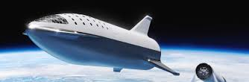
A thought experiment
Imagine 1,000 Earthlings are founding Beta, a settlement in space. You have won the lottery to go. The trip is 9 months.
You and the 999 other settlers must design your society.
This raises many questions:
  What would you want Beta’s society to be like?
  What problems with Earthly societies should Beta avoid?
  When do you want to decide on Beta’s economic and political structures? On the trip in the ship, or once you arrive at Beta?

Slide 40
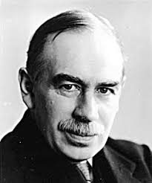
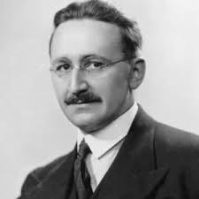
Why deciding when matters (part 1)
Prior to settling Beta: All we need is reason to design society
  We know how to reinvent society
  John Maynard Keynes: "ideas of economists and political philosophers, both when they are right and when they are wrong, are more powerful than is commonly understood.”
After settling Beta: Society will best emerge from experience
  Reinvention via reason is unwise
  Friedrich A. Hayek: “the curious task of economics is to demonstrate to men how little they really know about what they can imagine they can design.”

Slide 41
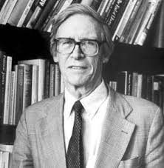

Why deciding when matters (part 2)
Prior to settling Beta =
The state as insurance
  “We’re in this together”
  John Rawls’s “veil of ignorance”
After settling Beta =
The state as voluntary cooperation
  “We’re together by choice”
  Robert Nozick’s “Libertarianism”

Slide 42
Why we’re going to space
Settling space will allow us to ask these questions anew in a host of societies designed from scratch
Think “supraurbanization” and Tiebout theory
Moreover, asking these questions about societies in space help us ask them about our society on Earth in a new way

Slide 43
What role can economists play?
Inform government policy through academic research that applies our existing tools to the questions of space (IO, development, growth, public)
Provide business leaders with frameworks for thinking about challenges, again applying existing tools but to space
Problem with both of these: not likely to get anyone tenure (though see the lists of interesting questions throughout my JEP paper for applied projects)
How about using the new playing field to imagine and develop new institutional designs that can be tried? (e.g., Posner and Weyl’s Radical Markets proposals)
  Optimal taxation and public goods provision
  Land use policy, zoning
  Antitrust policy
  Electoral systems
  etc…!
If you’re interested, let me know! (www.economicsofspace.com)

